Slide 1


Data-Driven Chemistry:
Fitting data
Dr Antonia Mey
Dr Matteo Degiacomi
antonia.mey@ed.ac.uk
Room 214 JBB

Slide 2

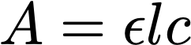
Finding the line of best fit: an example
Now the model is the line of best fit that will allow us to identify an unknown concentration
How do we find the line of best fit?

Slide 3
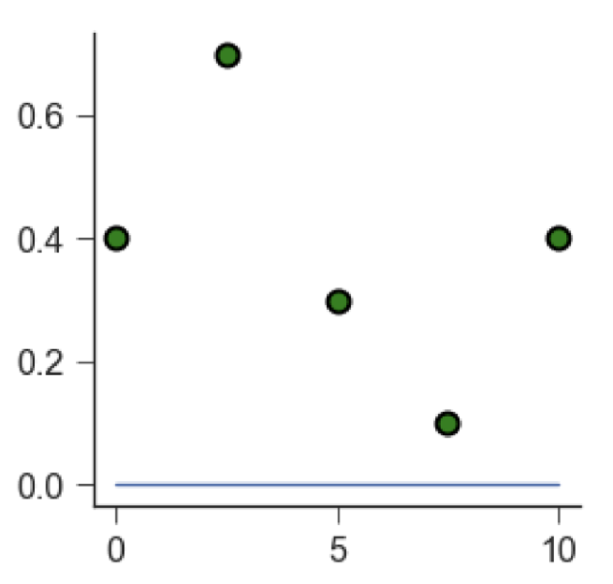
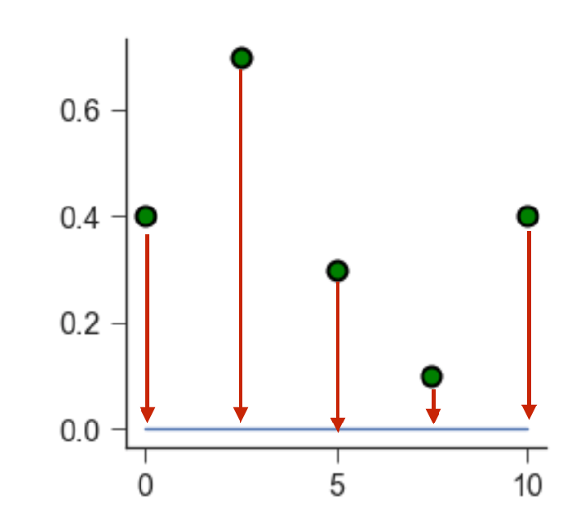
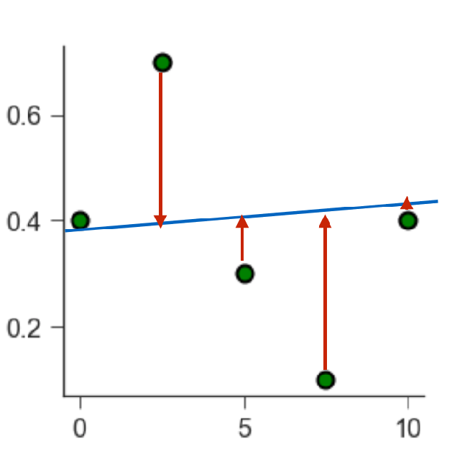
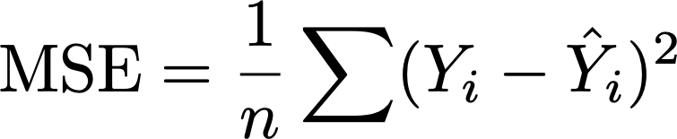
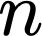
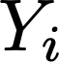
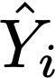
Linear regression means finding the minimum of an objective function
The blue line is meant to fit the green data points.
Red arrows are a called residuals and small arrows mean a good fit.
The objective is to minimise the mean square error
MSE is called the objective function
is the number of data points,
is the observed value (i.e. the measured data point),
is the predicted value (i.e. the value that lies on the line of best fit).

Slide 4
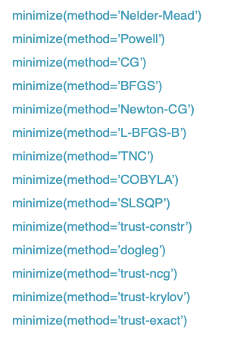
Finding the minimum in high dimensions
Using least squares let’s you find the best solution.
There are different algorithms that let you find the minimum of an objective function.

Slide 5
Finding the line of best fit in action

Slide 6
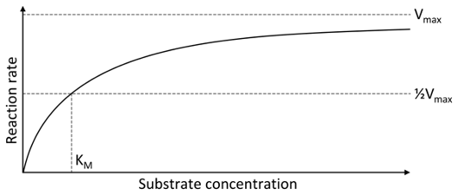
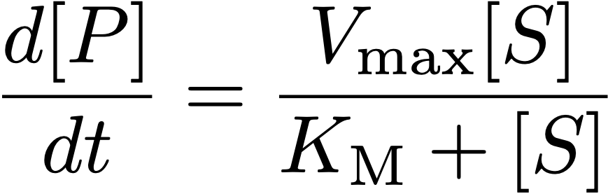
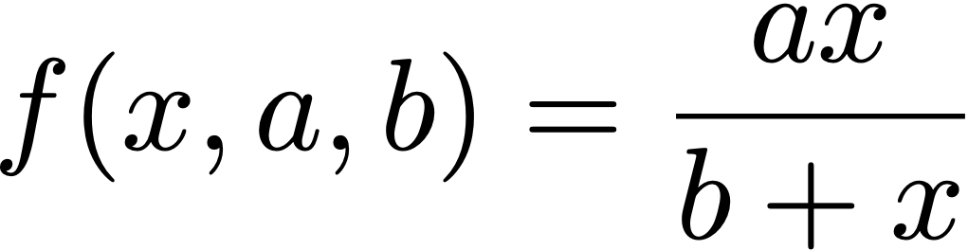
Non-linear Least squares
Non-linear combinations of model parameters, e.g. Michaelis Menten

Slide 7
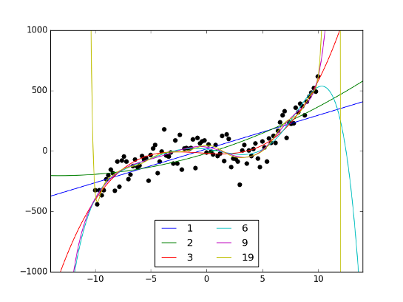
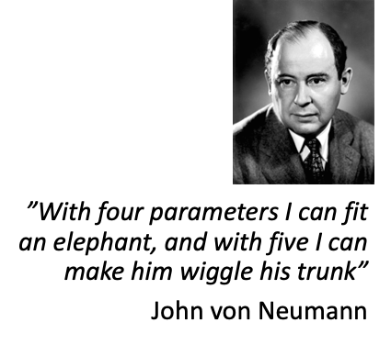
The more parameters the better the fit?
Notes:
Noisy 3rd order polynomial
Blue line matches poorly
3 it looks better
6 is quite accurate around your data
More parameters you add the better your data is explained.
Explaining whatever explains nothing -> overfitting.

Slide 8
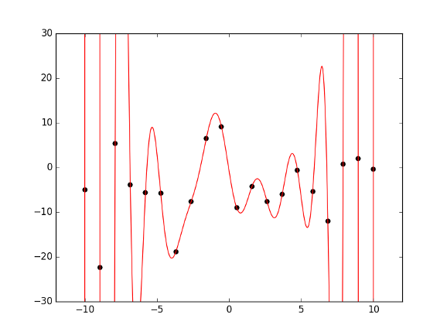
The more parameters the better the fit?
N points can be perfectly fitted with an N-1 order polynomial
Notes:
An N-1 will perfectly through every datapoint, but the usefulness of the model is 0. And the generalisability is also 0.
You don’t want models that only perfectly explain your data.

